Slide 1

Technical Foundation
KG Microcollege

Slide 2
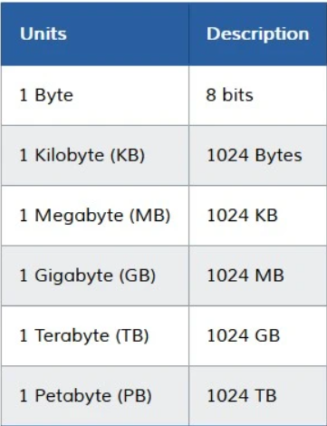
Understanding Binary
Data Representation
Data – Any Information that has to be stored is data. Ex: Text, Image, Videos, etc.
Space – Data also has size and occupies space on the storage device.
Data-Size – Space occupied by data is measured in the units of Bits and Bytes

Slide 3
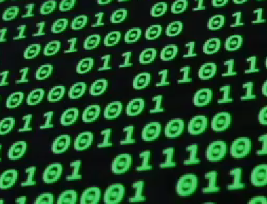
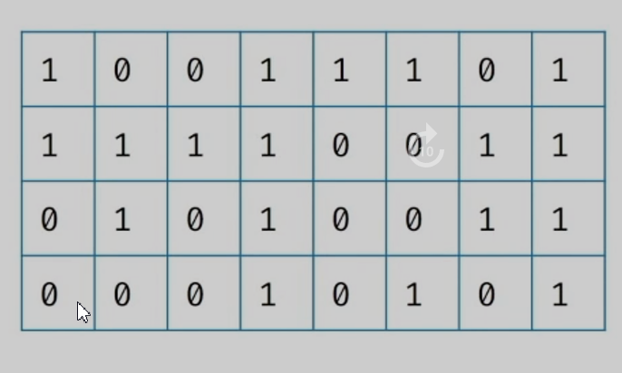
How Computer See Information
Binary – Ones (1) and Zeros (0)
A Binary number is a number expressed in Ones (1) and Zeros (0)
Binary Representation
If a number is represented using Zeros and Ones then the representation is called Binary Representation.
Each box can be considered as a Bit. It can hold either a Zero or a One.
Each bit (Binary Digit) is the basic unit of information in a computer.

Slide 4
Number Systems
A writing system for expressing numbers.
Decimal Notation:
Digits: 0 – 9
Ex: 4175
Decimal Representation:
4 X 10³ + 1 X 10² + 7 X 10¹ + 5 X 10⁰ = 4175
Radix/Base:
The number of unique symbols or digits used to represent numbers in that notation is called the Base.
Decimal Notation Has Base: 10
Binary Notation Has Base: 2
Binary Notation:
The only notation that computers understand.
Digits: 0, 1
Ex: 1101
Binary Representation:
1 X 2³ + 1 X 2² + 0 X 2¹ + 1 X 2⁰
8 + 4 + 1 = 13

Slide 5
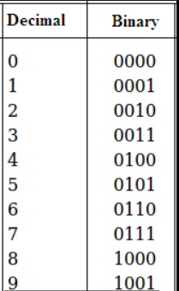
Counting Numbers In Binary

Slide 6
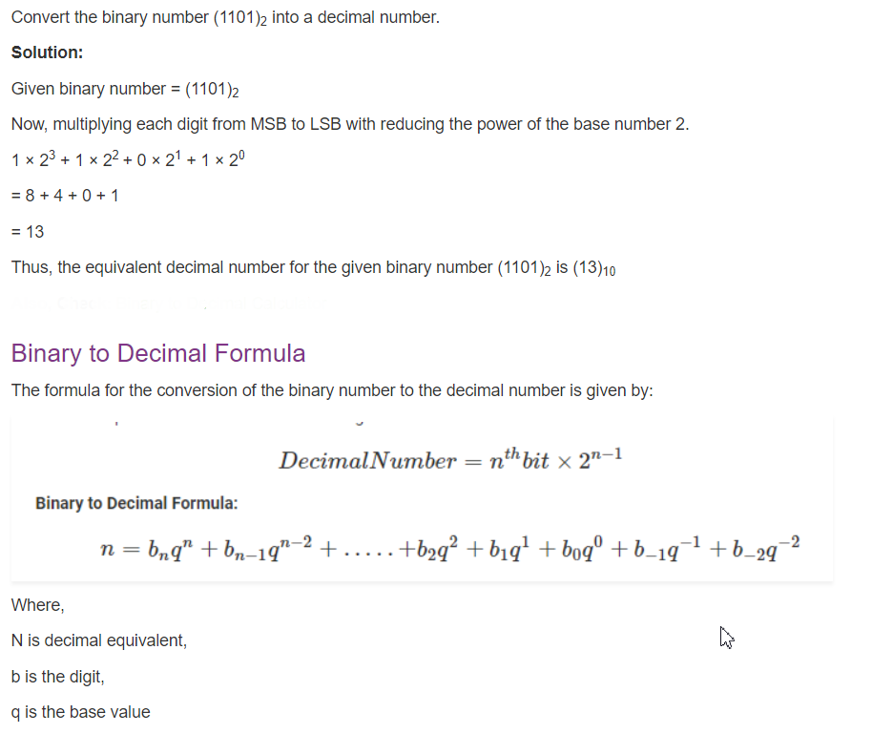
Steps to Convert Binary to Decimal:

Slide 7
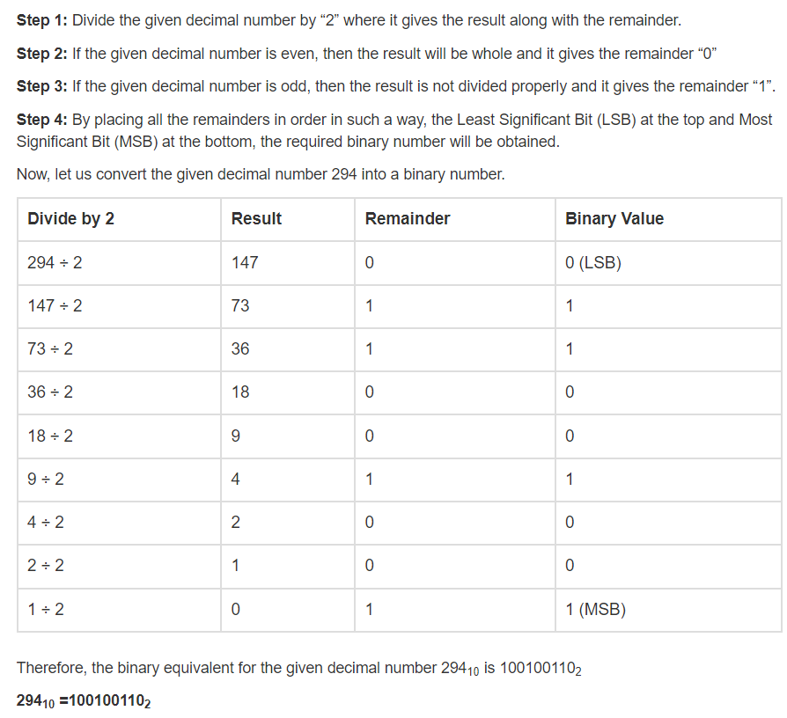
Steps to Convert Decimal to Binary:

Slide 8
Decimal To Binary Conversion
Base | Num | Rem
2 | 13
2 | 6 | 1
2 | 3 | 0
2 | 1 | 1
 | 0 | 1
13(10) = 1101(2)

Slide 9
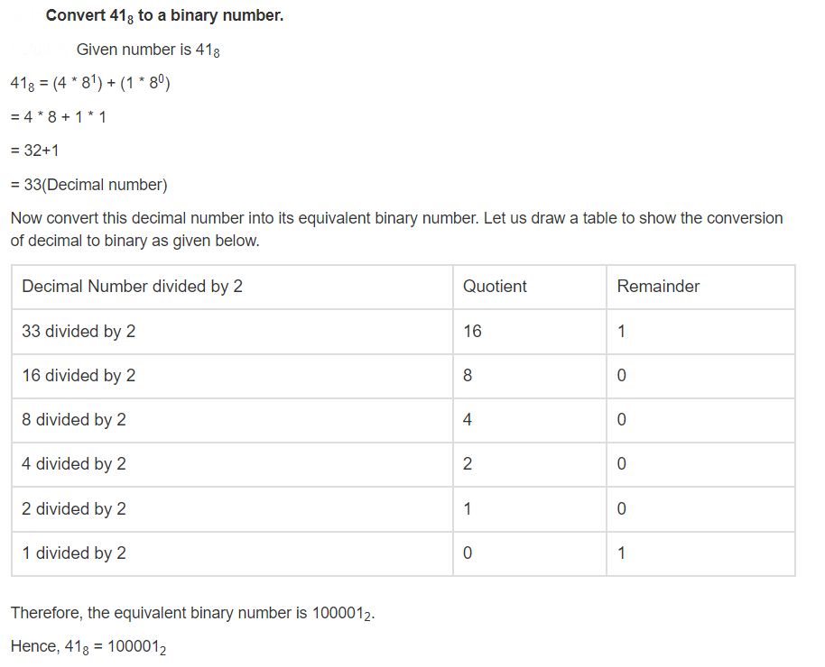
Steps to Convert Octal to Binary:

Slide 10
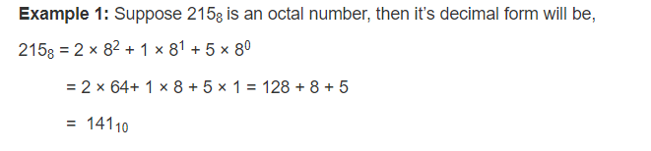
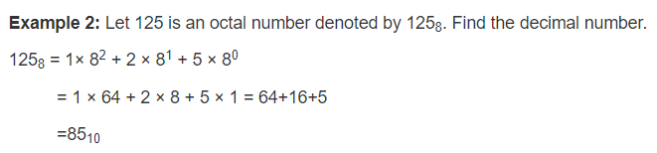
Steps to Convert Octal to Decimal:

Slide 11
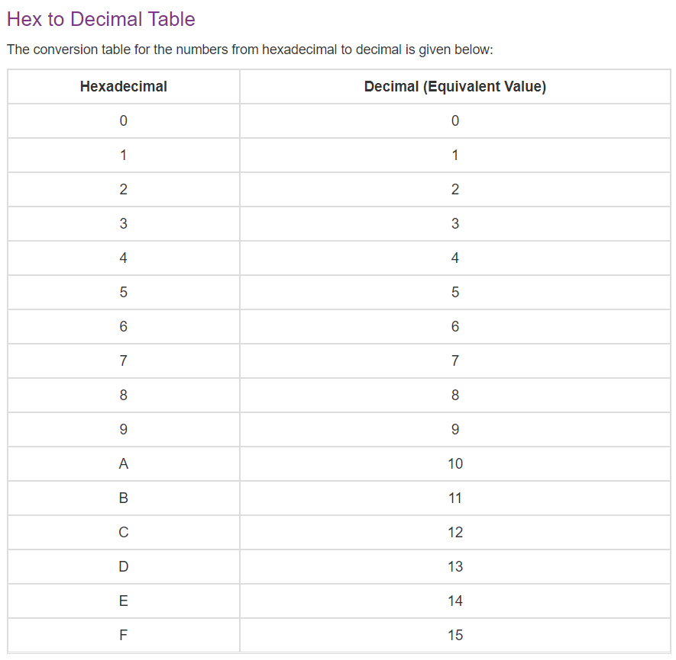

Slide 12
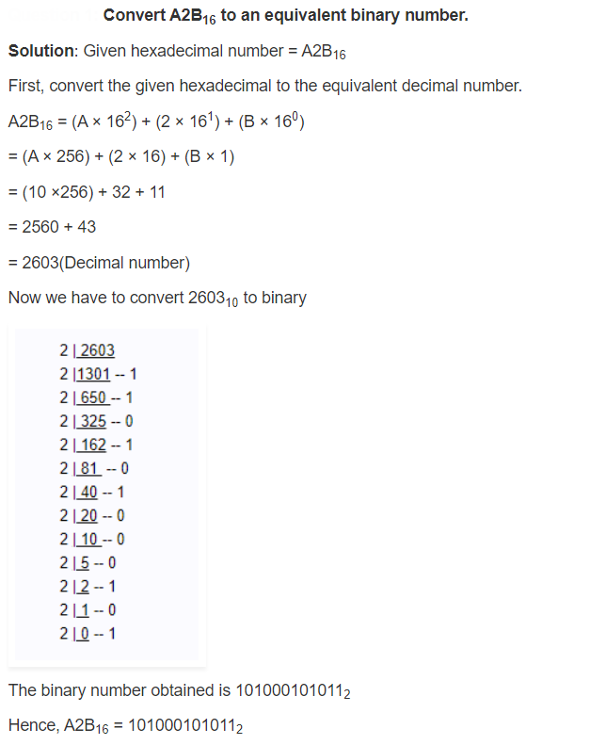
Steps to Convert Hex to Binary:

Slide 13
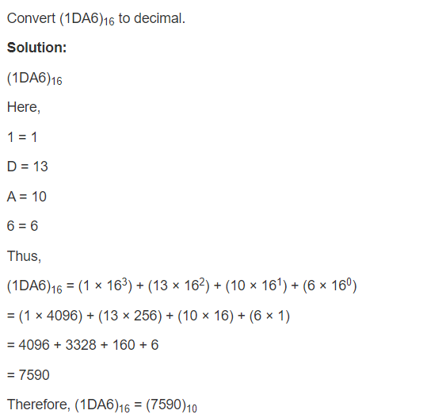
Steps to Convert Hex to Decimal:

Slide 14
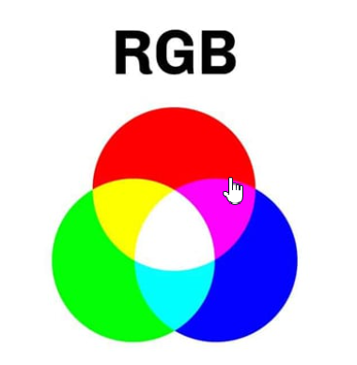
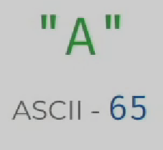
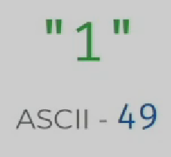
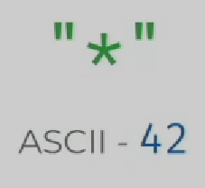
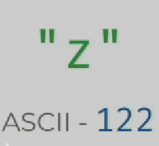
Binary Representation Of Images
Each Image has pixels. Each Pixel has a specific color.
Can use RGB model to represent colors.
Binary Representation Of Text
Each character is encoded as an integer which is represented by a binary value.
ASCII:
American Standard Code for Information Interchange(ASCII).
Represents the English alphabet, digits, and punctuation marks.
Requires only one byte to store a character.

Slide 15
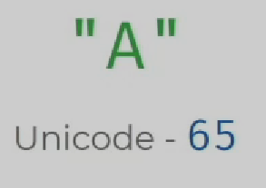
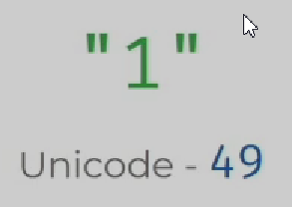
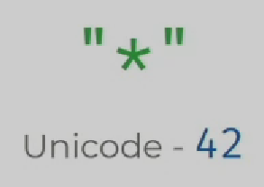
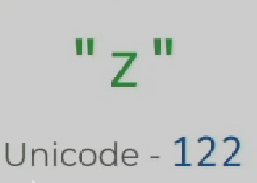
Unicode
A byte can only represent 256 different things.
Limit on No.of.Characters that can be represented.
Unicode allows us represent characters using more than 1 byte.
UTF-8
UTF-8 (Unicode Transformation Format – 8).
Capable of storing 1, 112, 064 different characters.
Has same values for ASCII characters.

Slide 16
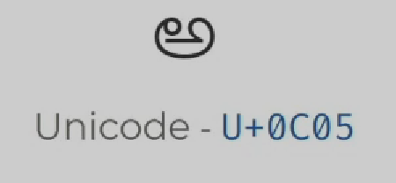
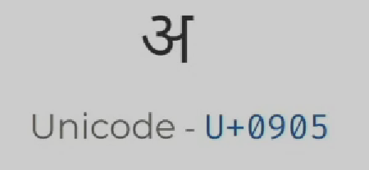
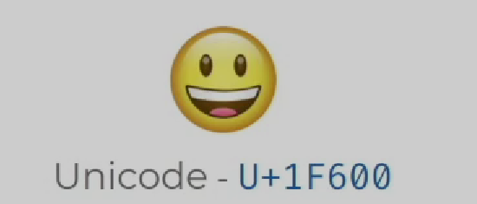

Slide 17
Key Takeaways
Data Representation
Binary & Decimal Number Systems
Conversion between Binary & Decimal
Representing Images
Pixels & RGB Colors
Representing Text
ASCII & UTF-8

Slide 18
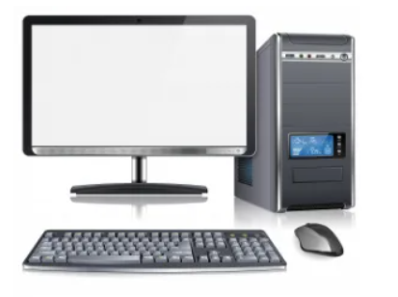
Computer Hardware
Computer hardware is the physical components that a computer system requires to function. It can be categorized as having either internal or external components.

Slide 19
Internal Components:
Component parts that are found inside the computer's CPU case are
Motherboard
Processor & RAM
Graphics Card (GPU)
Fans
Hard Disk etc.,
External Components:
External hardware components or peripherals are usually input/output devices that are
Keyboard & Mouse
Monitors & Speakers
USB Drives
Webcam

Slide 20
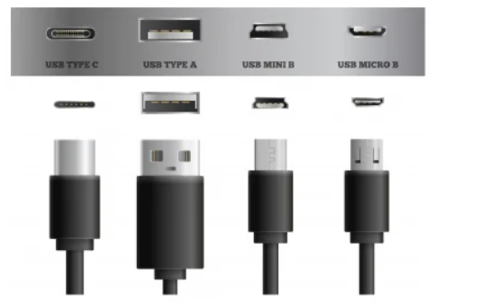
Ports:
Connectors or Ports allow us to plug in different components to a computer to enhance its capabilities.
The video display ports are DVI, VGA, and so on...
The video and audio ports are HDMI, display port, and so on...
USB Port:
Instead of having ports for different things, we can use USB (Universal Serial Bus) Port. USB is Designed to standardize many peripheral connections. In addition to audio and video, it allows data transfer and power. Recent mostly using USB is USB Type C which allows charging, data transfer, extend audio, video projection, etc.

Slide 21
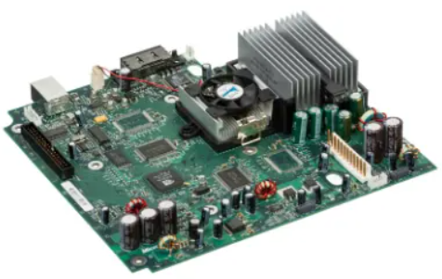
Motherboard:
The motherboard is the computer's central communication's backbone connectivity point through which all components and external components connect.

Slide 22
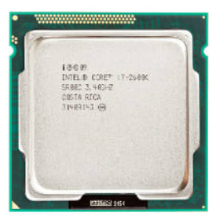
CPU:
The CPU (Central Processing Unit or processor) is responsible for processing all information from programs. It processes many instructions from different programs every second.

Slide 23
CPU Instruction Set:
Programs on the computer are broken down into very small and simple instructions.
For example,
Add two numbers
Load value from Memory Location
Store Value to Memory Location
CPU will only perform small operations in binary but lakhs of these operations are done in a single second.
CPU Clock Speed:
One of the performance matrices is clock speed which measures the number of instructions that the CPU can execute per second.
The CPU speed measured in gigahertz (GHz).
1 GHz = a Billion instructions per second
A higher clock speed means a faster CPU.

Slide 24
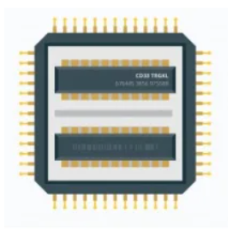
CPU Cores:
A CPU core is a CPU's processor. A core can work on one task. Modern-day devices have multiple cores. 8 core processor means 8 cores and similar to other cores. Each core of a CPU can perform operations separately from the others. They may work together to perform parallel operations.

Slide 25
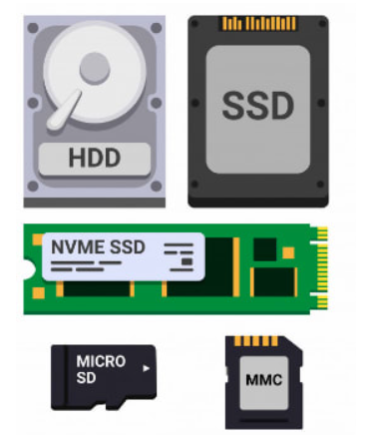
Hard Drive:
The hard drive is Non-volatile storage which is responsible for storing permanent and temporary data.
SSD (Solid-state drives) is 25 times faster than regular HDDs (Hard-disk drives)

Slide 26
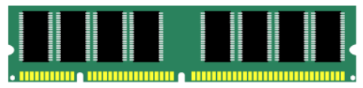
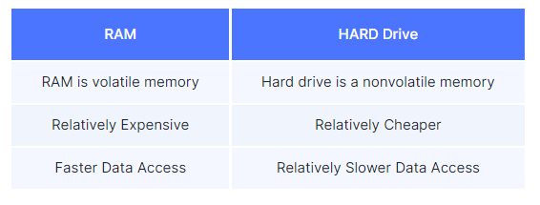
RAM:
RAM is also another type of storage. we can store photos, videos, etc. The RAM is measured in GB we might have heard a lot of times that 2GB RAM, 4GB RAM in Phones, Laptops, etc.
RAM is volatile memory means the data remains in RAM if the computer is on, but it's lost when the computer is turned off.
RAM is much faster to read and write than other types of storage.
RAM vs Hard Drive:

Slide 27
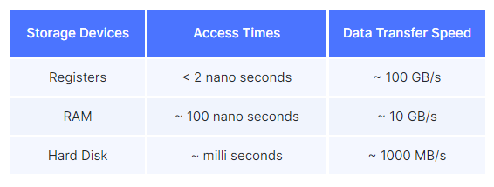
Registers:
Registers are another type of storage. Many times much faster than regular storage devices and even RAM which is placed very close to the CPU.
They are extremely fast and extremely expensive.
They are available in very little storage. Usually in MBs.
They are used to quickly accept, store, and transfer data and instructions that are being used immediately by the CPU.
Data Access Times in RAM, Hard Disk and Registers:

Slide 28
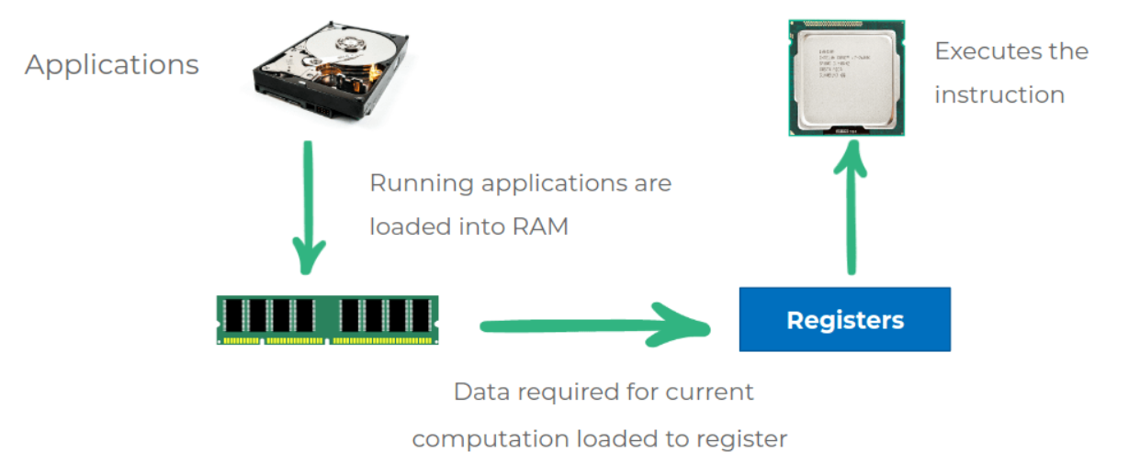
Running Applications:
All applications and programs are stored in a hard drive. As the hard drive is slow the running applications are loaded into RAM and as registers are faster than RAM the data required for current computation loaded to register are quickly accessible by the CPU. If the RAM is less, we can’t store much data while running multiple programs the system gets slow.

Slide 29
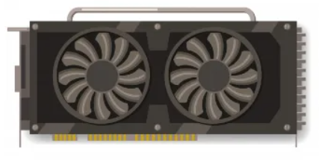
32-bit and 64-bit Systems:
A 32-bit processor includes a 32-bit register, which can store 232 values.
Can support up to 4 GB RAM
A 64-bit processor includes a 64-bit register, which can store 264 values.
Graphics Card:
Graphics Card is a Specialized processor designed to deal with specific types of instructions efficiently. It is used for 3D Rendering, Games, Deep Learning, and so on.

Slide 30
CPU vs GPU:
CPU | GPU
A CPU can perform a variety of different instructions | GPU can perform a specialized set of instructions
Has few cores (around 2 - 8) | Has 1000s of Cores. Good at parallelization

Slide 31
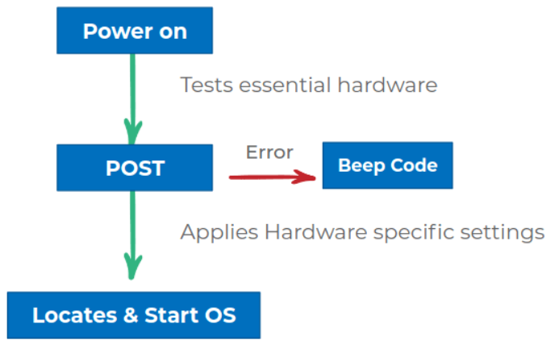
BIOS:
Basic Input Output Services (BIOS) initializes the hardware and gets our operating system up and running.
After system power on the first BIOS tests, the hardware is working or not. you will hear a combination of beeps indicating what is the hardware status(Having any error or not). If you didn't hear beep sounds it means there are no built-in speakers in the system.
If the test is a success then it handovers hardware to the operating system.

Slide 32
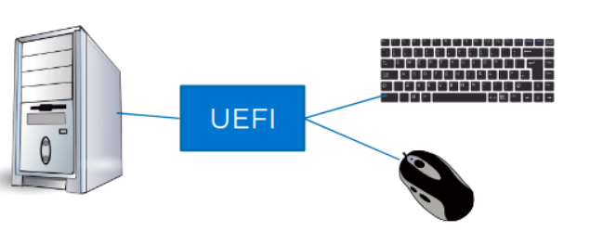
UEFI:
UEFI (Unified Extensible Firmware Interface) is similar to BIOS, which supports the latest hardware
It performs a secure boot
It performs faster boot

Slide 33
Key Takeaways
External Components
Ports
Internal Components
Motherboard
RAM
Hard Drive
Registers
RAM vs Hard Drive
CPU
Processor
CPU Core
32 – bit and 64 – bit systems
Graphic Card (GPU)
BIOS & UEFI

Slide 34
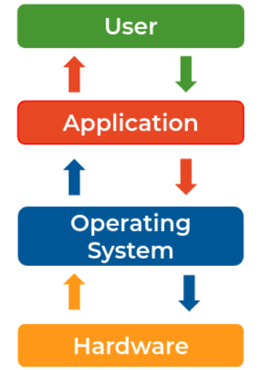
Introduction to Operating System
Operating System:
Operating System is an interface between hardware and software.

Slide 35
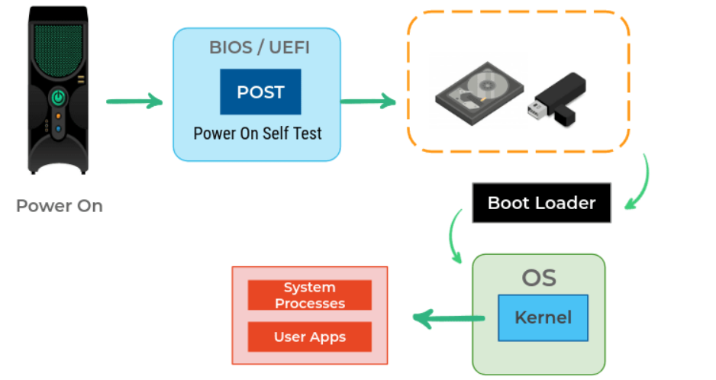
Boot Process:
Power on
Computers run a test to make sure all the hardware is working correctly this is called a Power On Self Test(POST).
Based on the BIOS configuration, a boot device(HDD, CD, or USB) that contains OS is selected for a program known as a boot loader which then loads the operating system.
Once OS gets loaded the essential part of OS Kernel is started and appropriately set for us to use.

Slide 36
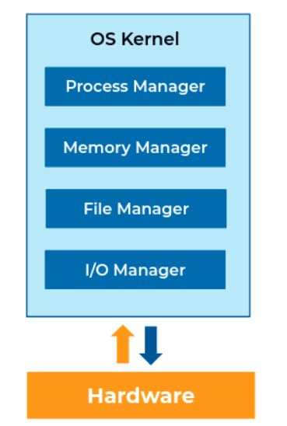
OS Kernel:
The Kernel is the core component of OS. As users, we don't interact with the kernel directly.
It interacts directly with the hardware.
It manages the hardware resources.

Slide 37
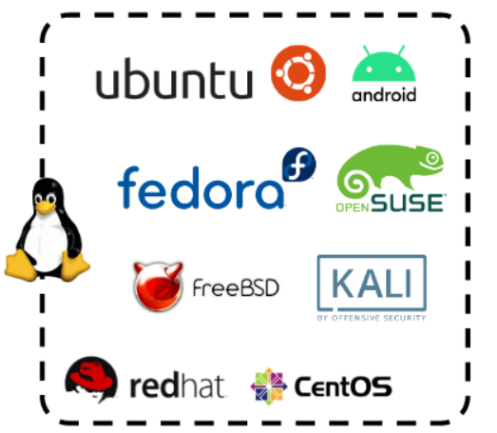
Linux Kernel:
Linux is a free and open-source OS Kernel developed by Linus Torvalds.
Operating Systems made from software based on Linux Kernel are referred to as Linux Distributions (or Linux Distros).

Slide 38
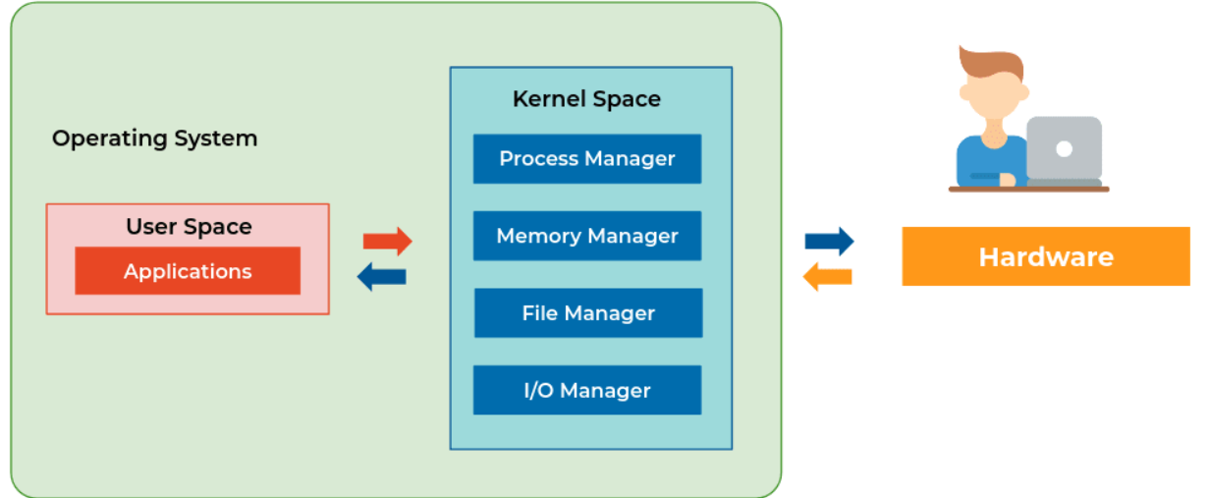
Components of OS:
Broadly we can categorize components of os are
Userspace
Kernel
All apps interact with the kernel. The kernel will interact with hardware

Slide 39
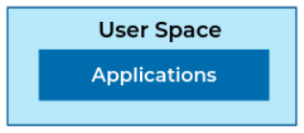
Userspace:
Userspace is everything outside the kernel.
Programs we interact with directly are part of Userspace which are Text Editors, Music Players, User Interfaces, etc.
Userspace can include some OS programs like the GUI etc.

Slide 40
Responsibilities of OS:
Abstraction:
Abstraction means hiding the unnecessary complex inner details and showing only the relevant features. Once the operating system is up we no longer deal with the internals. For example, consider a car driver he does need to know how the engine works in the car. he/she simply needs to know few things like steering, gear, and so on.
Operating System abstracts away the complex details of the underlying hardware.
It provides a common API to applications and services.
Thus, It simplifies development applications.
Resource Management:
Resource management is one of the important tasks for OS. power, memory, CPU, and so on are resources. For example, Mobile/laptop use multiple applications at the same time like chrome, music app, chat app. These applications required CPU, ram, GPU resources.
Operating System allocates hardware resources to applications in a fairway.
It makes efficient use of the limited resources.
It prevents improper use of computer resources.

Slide 41
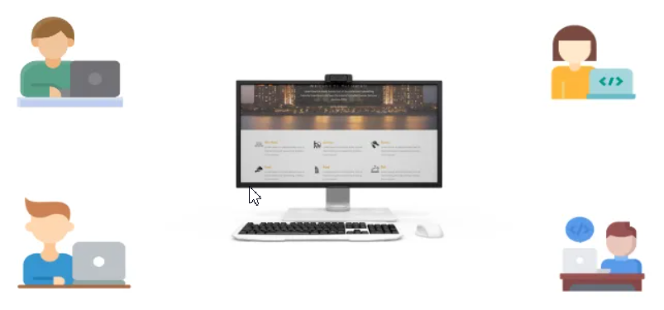
Isolation and Protection:
Operating System Provides a safe way for multiple applications to simultaneously run without interfering with each other.
It protects applications from each other. If one application fails Operating System ensures that it does not affect others.
Multi-User System:
In Laptops, computers, multiple users can access at the same time. Resource management between the apps used by each user is the responsibility of the operating system.

Slide 42
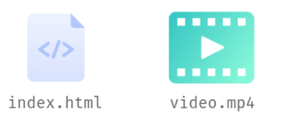
File and File Systems:
File:
A file is a collection of related information that is stored on the storage medium.
File Extensions:
Files may have an extension that is used to denote the type of file.
Programs open and operate files based on the file extension.
Image & Video Extensions: .jpeg, .png, .tiff, .mp4, .mov
Docs: .html, .js, .py, .docx, .txt

Slide 43
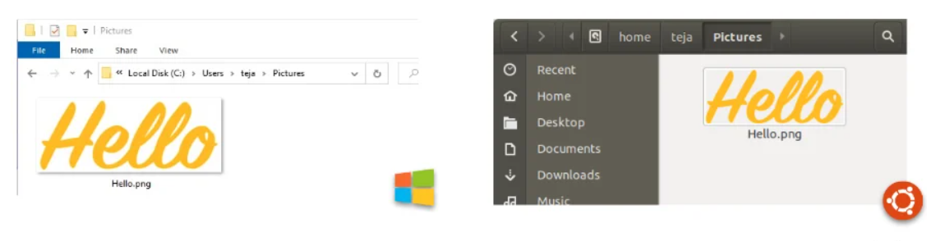
Files and Folders:
Usually, we organize files in folders and these folders are stored in other folders and this continues until we arrive at C:\ drive or some other drive in Windows and Root directory ( / )in Linux-based systems and macOS.

Slide 44
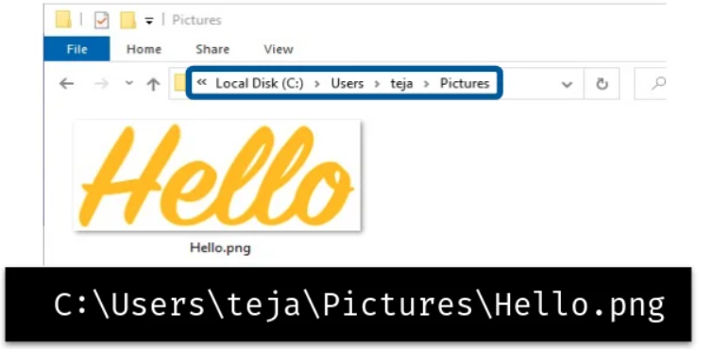
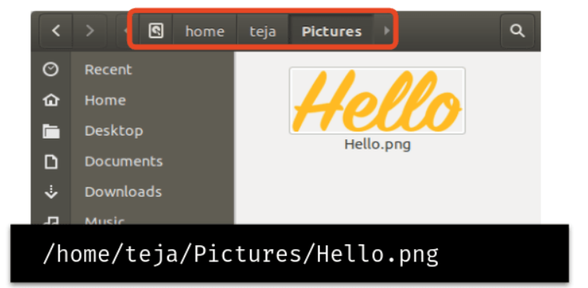
File Path:
The general form of the name of a file or directory specifies a unique location in a file system.
File path usually is folder names separated by slashes.

Slide 45
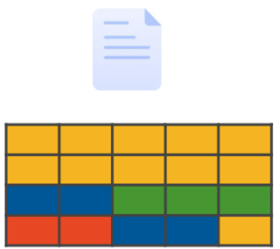
File and File Systems:
The kernel handles file storage on our machines. There are three main components to handling files on an OS.
File System
File Data
File Metadata
File Data:
The data of a file is broken down into pieces of data blocks of a fixed size before storing in a disk.
Default Block Size is 4 KB. So, the size occupied by a file on the disk will be in multiples of 4 KB.
Block storage improves faster handling of data because the data isn't stored on one long piece and it can be accessed quicker. It's also better for utilizing storage space.

Slide 46
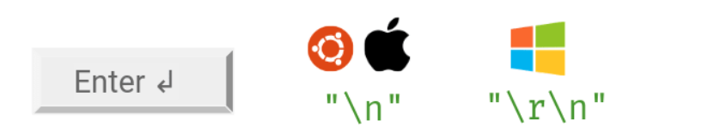
File Content
Though everything is stored in binary, files can be classified
Text Files
Non - Text Files
Text Files:
Consists of plain, unformatted words, letters, and punctuation (Unicode Characters) intended to be readable by humans. The text files can be opened by any text editor.
e.g. All Code files and plain text files
Line Endings:
The line ending character when Enter ↲ is typed is different in different Operating Systems.

Slide 47

Non-Text Files:
Consists of non-textual data meant primarily to be read by applications that translate those content into something useful by humans.
Pictures, Audio, Video, Rich formatted text (Docs), etc.
File Metadata:
The file metadata contains the information about our file.
Owner of File
Permissions (Read, Write, Execute)
File Size
Creation Date Time
Last Modified Date Time

Slide 48

File Systems:
Responsible for managing files on the disk.
Provides a mechanism to store the data and access the file contents including data and programs.
Different file systems were developed for different use cases.
File System determine various aspects like
Limitations on File Size and File Names
Size occupied on the disk
Encryption
File Search
Backup & Versions

Slide 49

Case Sensitivity:
Each File System has its own rules, preferences, etc. Similarly, some File Systems are case sensitive. A case-sensitive file system distinguishes between uppercase and lowercase letters in file names and treats them as different files.
Ext4 (Linux) is case-sensitive.
NTFS (Windows), APFS (Mac), FAT are case-insensitive.

Slide 50
Key Takeaways
Operating System
Abstraction
Resource Management
User Space & Kernel Space
OS Kernel
File & File Systems
FAT, NTFS, EXT4, APFS
Case Sensitivity
File Metadata & Extension
File Paths
Text Files and Binary Files
Line Endings

